Slide 1
Graphic Crypto Screener for tradingview Revolutionizing Crypto Market Analysis
Awaken Tech Research Team
July 2025

Slide 2
Agenda
The Challenge: Limited Crypto Monitoring
Introducing Graphic Crypto Screener
Key Features and Benefits
Technical Insights
Future Vision with Machine Learning
Join Our Community

Slide 3
The Challenge in Crypto Trading
TradingView has limited securities group screening capabilities.
Pine Script presents limits for running up to 40 tokens per script.
Traders often miss a comprehensive market view.
Scalability limits hinder real-time decision-making.
Why It Matters: A broader view unlocks better trading opportunities.

Slide 4
Introducing Graphic Crypto Screener
Overview
Graphic Crypto Screener is a Pine Script tool for TradingView, designed to scan up to 120 selected crypto tokens across various timeframes.
Overcomes Pine Script's 40-token limit through an innovative design..
Supports customizable indicators (e.g., RSI, TSI, Stochastic Oscillator, ATR/Range), covering a spectrum of types including momentum, market level, and volatility.
Offers configurable display options for indicators, including repaintable or fixed views, and a "colored tail" to visualize a security's past position.
Includes a built-in algorithm to highlight tokens with significant volume surges.
Provides the ability to set customizable alarms when specific conditions are met.
Awaken Tech Research Team

Slide 5
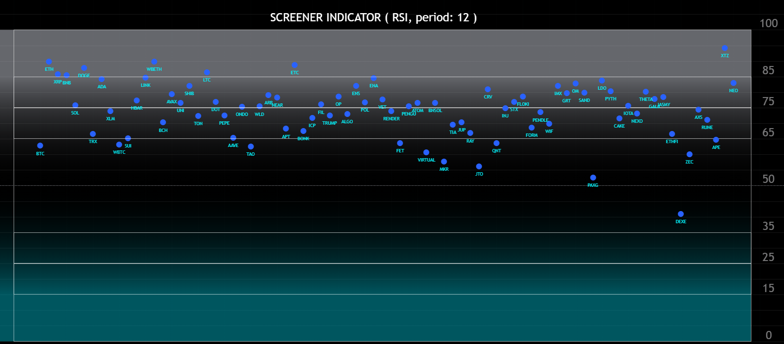
Graphic Crypto Screener
Screenshot of RSI Screener with selected 80 tokens, daily Timeframe.

Slide 6
Key Features
120 Token Monitoring: Overcomes Pine Script's 40-token limit.
Multi-Timeframe Insights: Analyzes data across various timeframes.
Customizable Indicators: Supports a wide range of indicators.
Color Customization: Offers extensive display personalization.
Seamless Integration: Fully integrates with TradingView.
Real-Time Scalability: Ensures scalable, real-time updates.
Advanced Alerts: Provides customizable alarms and WebSocket integration.
New Indicators Added: Continuously expanding analytical capabilities.

Slide 7
Benefits for Traders
Scenario: Track 120 tokens in real-time and spot trends across timeframes effortlessly.
Comprehensive Market Overview: Gain a complete market perspective in a single, intuitive view.
Enhanced Flexibility: Benefit from superior adaptability with fully customizable indicators.
User-Friendly for All Levels: Ideal for both novice and expert traders.

Slide 8
How It Works
Data: Real-time crypto price feeds from TradingView.
Design: Pine Script optimized to scan 120 tokens.
Visualization: Intuitive graphic display of indicator values.
Limitation: Requires multiple script instances for full scale.
Agregated Market Data)
Algorithm (Selected Indicator)
Graphic Output Resume

Slide 9
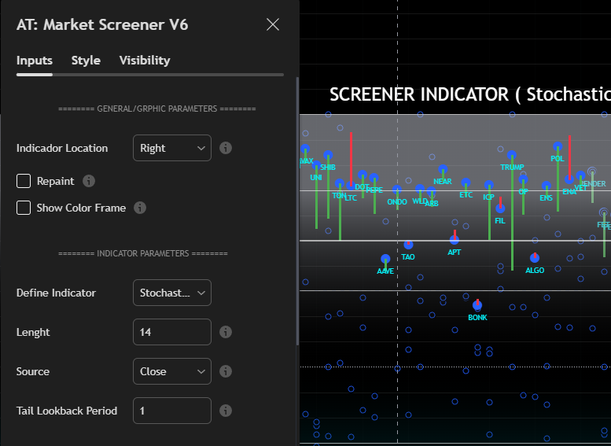
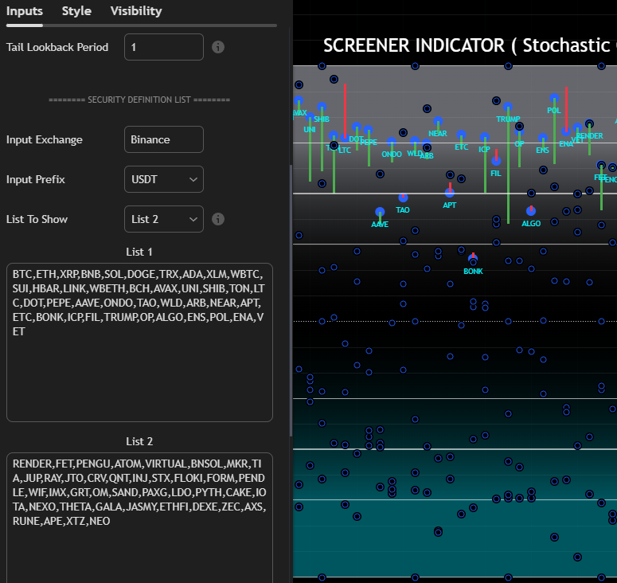
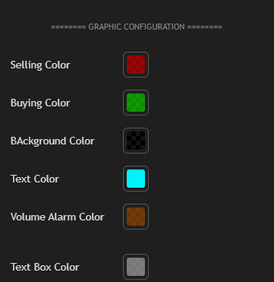
Customization Options

Slide 10
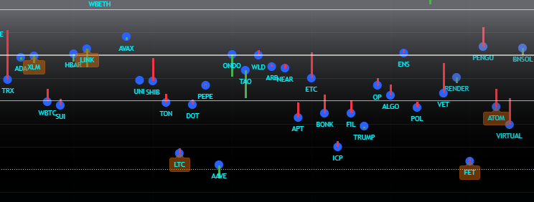
Advanced Visualizations
Colored Tail Showing Past Close Position
Volume: Highlighted Frame

Slide 11
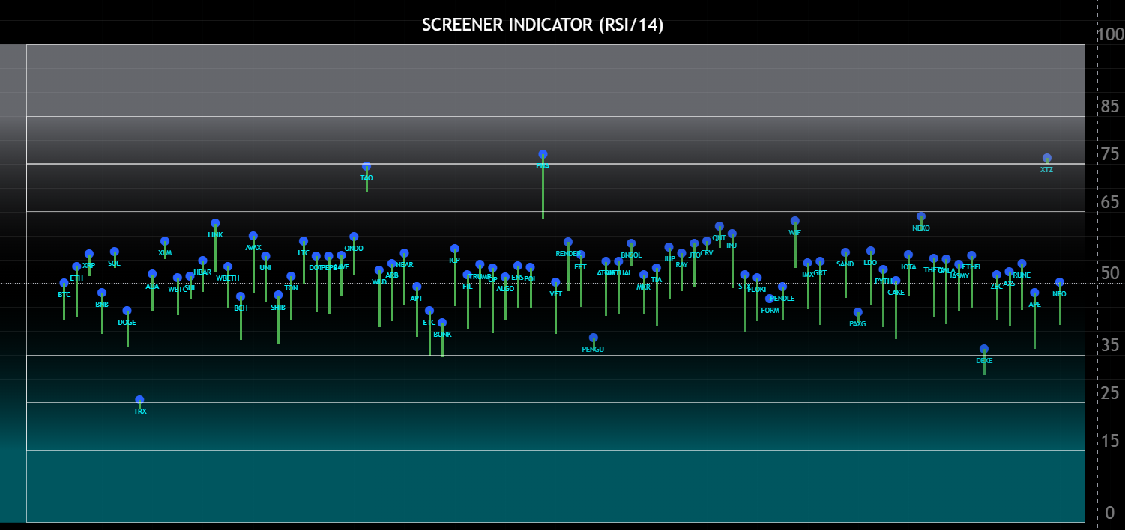
Synchronized Block Movements Detected via RSI (15min TF)

Slide 12
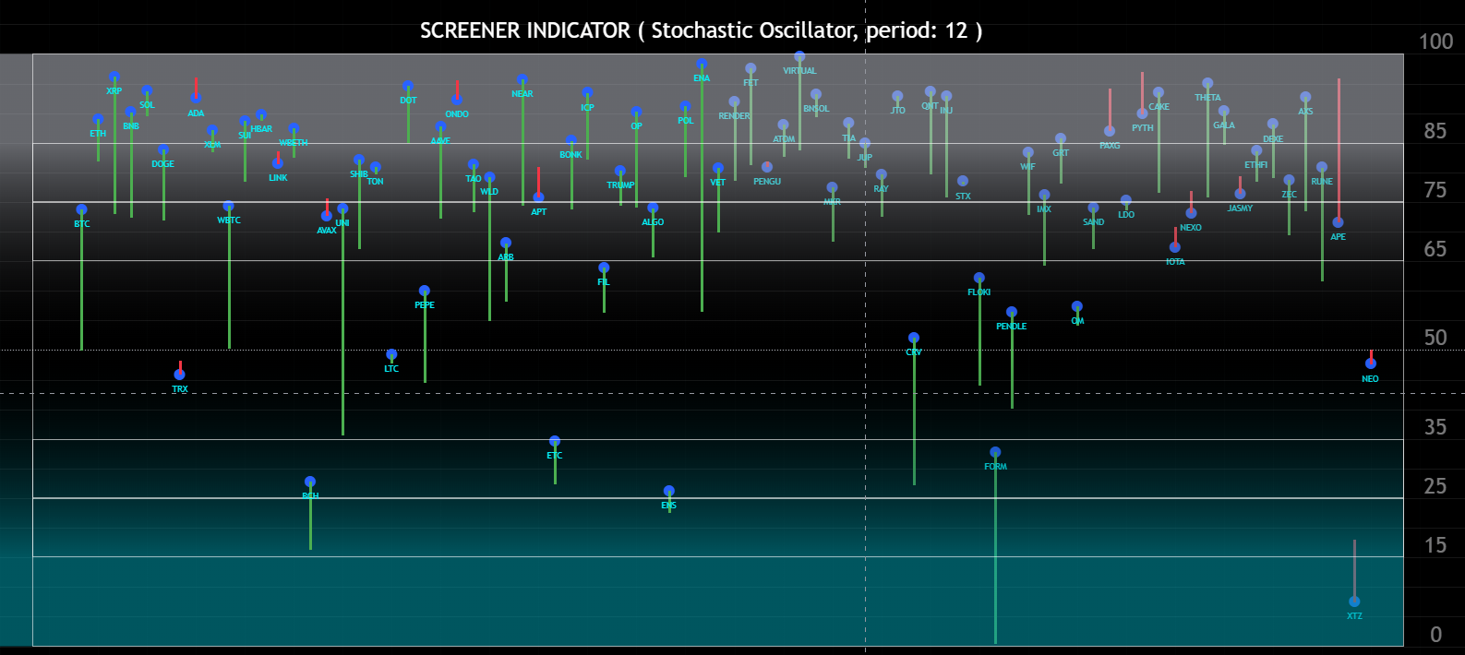
Advanced Visualizations Stochastic Oscillator

Slide 13
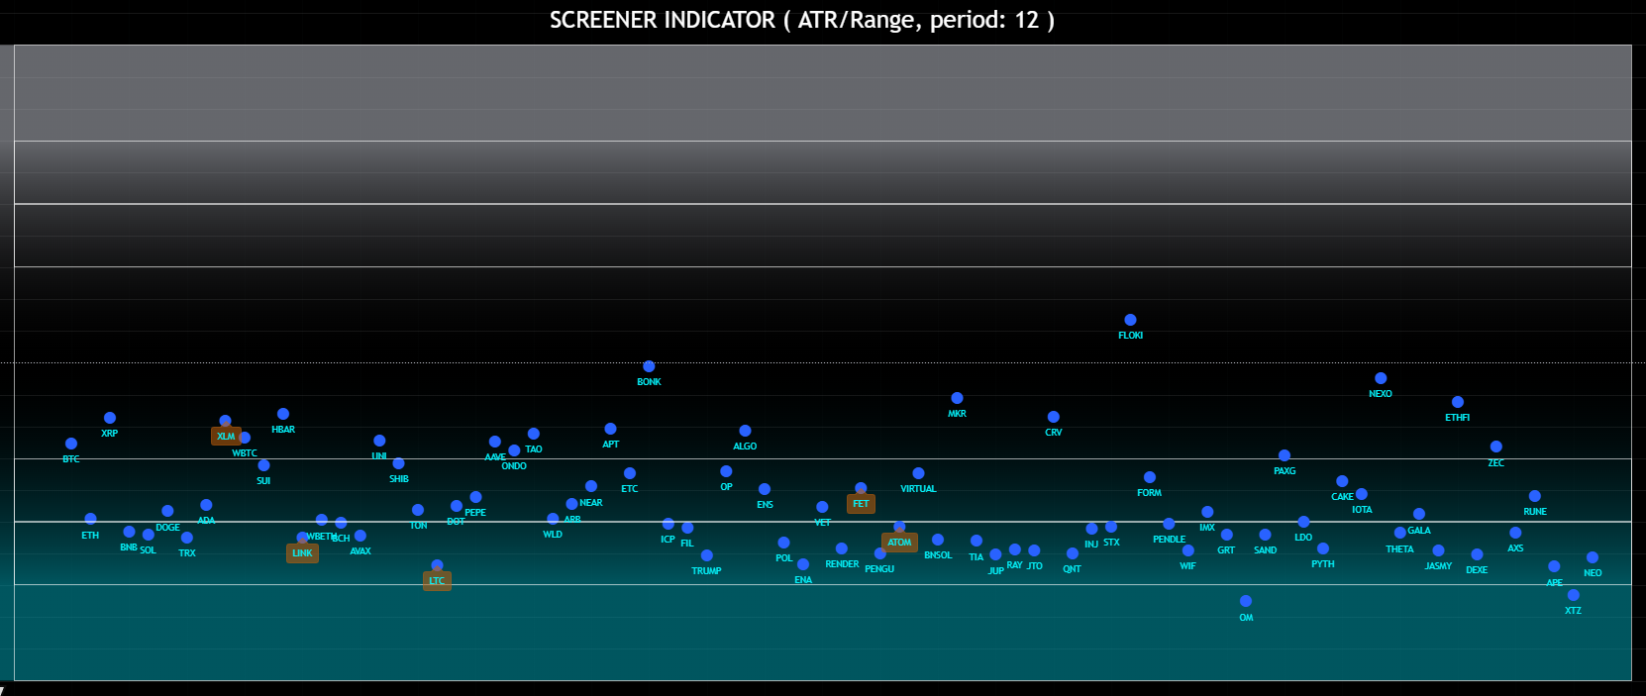
Advanced Visualizations: Volatility (ATR/Range)

Slide 14
Future with Machine Learning
Goal: Apply ML to evaluate market conditions.
Benefits: Predict trends and identify opportunities.
Status: In development—stay tuned for updates!

Slide 15
What Makes Graphic Crypto Screener Unique?
Scalability: Monitors 120 tokens, beating Pine Script limits.
Flexibility: Supports multiple indicators and timeframes.
Innovation: Pioneering ML integration in progress.
Community-Focused: Built with trader feedback.
“A game-changer for crypto tracking!” — Anonymous Trader

Slide 16
Join Our Community
Explore Shark Radar at www. awakentech.ai.
Join our community: www.awakentech.ai/community.
Follow us on X: https://x.com/AwakenTechRes.
Sign up for a free webinar to see Shark Radar live.

Slide 17
THANK YOU
Awaken Tech Research: Empowering Traders
www.awakentech.ai
info@awakentech.ai

